Slide 1
Web Applications User Analysis
Analyzed & Visualized Dataset Insights

Slide 2
Web Applications User Data
Application Name | Number of Users
Google Search | 2 Billion
YouTube | 1.9 Billion
Facebook | 2.8 Billion
Gmail | 1.5 Billion
WhatsApp Web | 2 Billion
Amazon | 300 Million
Twitter | 330 Million
Zoom | 300 Million
LinkedIn | 740 Million
Google Drive | 1 Billion

Slide 3
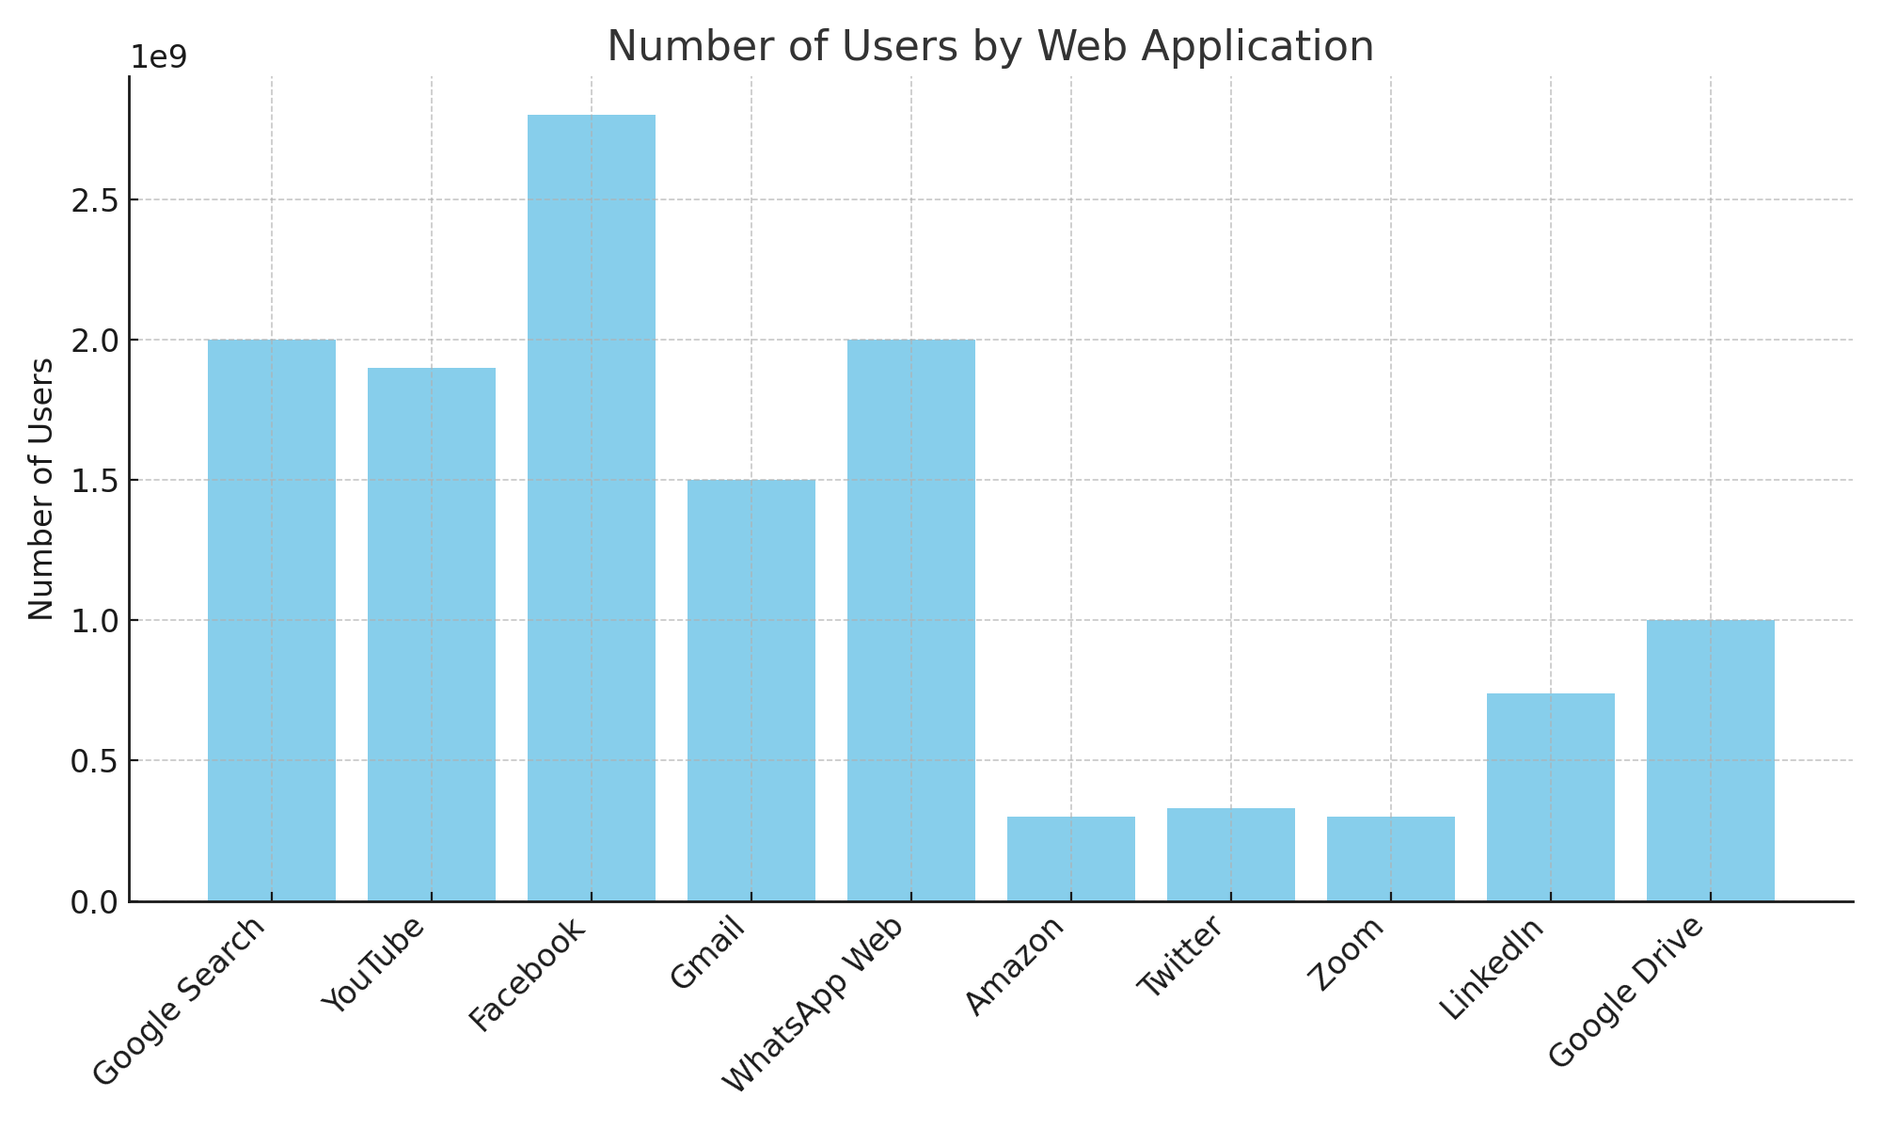
Web Applications User Data Chart

Slide 4
Insights
Facebook has the highest number of users (2.8 billion).
Google Search and WhatsApp Web have 2 billion users each.
YouTube follows closely with 1.9 billion users.
Amazon, Twitter, and Zoom have around 300 million users each.
LinkedIn has a solid user base with 740 million users.

